Slide 1
Stakeholder Analysis and Management
Notes:
This presentation was automatically generated by PowerPoint Copilot based on content found in this document: https://1drv.ms/w/c/1c3ede0d57884f42/EQjCBBocCaFDtZSI4CW7rTUBCANSkVTIchv3Bs9Qu4He4A?e=Vsyqw9 AI-generated content may be incorrect.

Slide 2
Agenda
Introduction
Stakeholder Categories and Identification
Analyzing Stakeholders
Stakeholder Management Strategies
Summary of Stakeholder Management Strategies
Managing Stakeholders
Defining Stakeholder Involvement – RACI and RASCI Charts
Using Social Media in Stakeholder Management
Understanding Stakeholder Perspectives
Summary
Notes:
Agenda * Introduction * Importance of Stakeholder Management * Roles in Stakeholder Management * Stakeholder Categories and Identification * Definition and Identification of Stakeholders * Customer Categories * Partner Organizations * Supplier Categories * Competitors * Regulators * Owners * Employees and Managers * Other Stakeholders * Analyzing Stakeholders * Assessment of Stakeholder Issues * Power/Interest Grid * Stakeholder Management Strategies * Low Interest and Low Power * High Interest but Low Power * Low Interest but Some Power * Low Interest but High Power * High Interest and High Power * Individuals and Groups of Stakeholders * Overview of Strategies * Managing Stakeholders * Dynamic Stakeholder Positions * Stakeholder Management Plan * Defining Stakeholder Involvement – RACI and RASCI Charts * RACI Chart Explanation * RASCI Chart Explanation * Using Social Media in Stakeholder Management * Researching Stakeholders * Communicating with Stakeholders * Understanding Stakeholder Perspectives * Introduction to Perspectives * Soft Systems Methodology * CATWOE Analysis * Business Activity Models * Activity Threads in BAMs * Effective Stakeholder Management

Slide 3
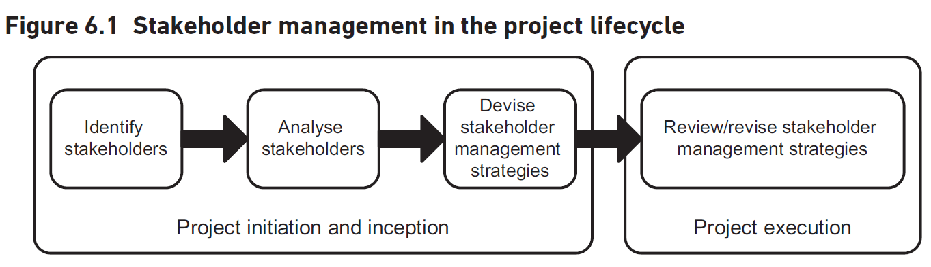
Importance of Stakeholder Management

Slide 4

Roles in Stakeholder Management
Project Manager or Senior Business Analyst
Main responsibility for stakeholder management
Team Members
Identify stakeholders
Understand stakeholder needs
Manage stakeholder expectations
Notes:
Stakeholder management is primarily handled by the project manager or a senior business analyst. However, all team members contribute by identifying stakeholders, understanding their needs, and managing their expectations. Original Content: The main responsibility for stakeholder management may rest with the project manager or with a senior business analyst. However, all team members have important roles to play, in identifying stakeholders, in helping to understand their needs and by helping to manage their expectations of the project

Slide 5
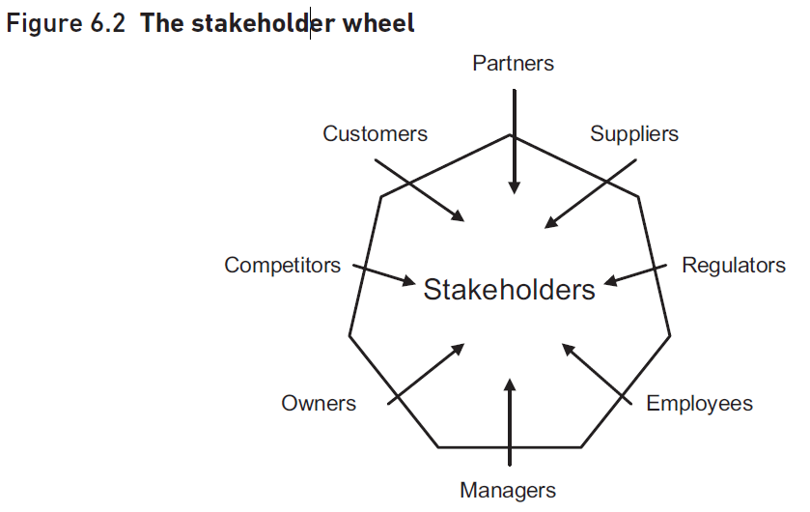
Definition and Identification of Stakeholders
Definition of Stakeholder
Anyone with an interest in the issue
Anyone affected by the issue
Importance of Identifying Stakeholders
First step in stakeholder management
Influence on the project
Notes:
The first step in stakeholder management is identifying who the stakeholders are. Stakeholders include anyone with an interest in or affected by the issue, and those who may influence the project. Original Content: As Figure 6.1 illustrates, the first step in stakeholder management involves finding out who the stakeholders are. A good working definition of a stakeholder is ‘anyone who has an interest in, or may be affected by, the issue under consideration’. This means, more or less, anyone affected by the project or who may be in a position to influence it.

Slide 6

Customer Categories
Stakeholders
Potentially affected by changes in the organization
Important to manage change effectively to retain customers
Customer Categories
Large or small
Regular or occasional
Wholesale or retail
Corporate or private
Commercial, non-profit, or public-sector
Civilian or military
Domestic or export
Good customers vs. difficult customers
Notes:
Our organization serves various stakeholders, including customers who may be affected by changes. We categorize customers into groups such as large or small, regular or occasional, and more. Effective change management is crucial to retain valued customers. Original Content: These are the people or organisations for whom our organisation provides products or services. They are stakeholders because anything we do in the way of change has a potential effect on them. We must consider how to manage that change most effectively so as not to lose customers that we wish to retain. It may be useful to subdivide this general category to reveal more detail about the stakeholders, for example into: large or small; regular or occasional; wholesale or retail; corporate or private; commercial, non-profit or public-sector; civilian or military; domestic or export. We may even have different categories that we simply label ‘good customers’ and ‘difficult’ customers’, however we define them. Customers

Slide 7

Partner Organizations
Types of Partner Organisations
Resellers of our products or services
Outsourcing companies providing specialist services
Roles of Partner Organisations
Providing specialist services on our behalf
Enhancing our service offerings
Notes:
Our partner organisations include resellers and outsourcing companies. They provide specialist services on our behalf, enhancing our service offerings. Original Content: Partners These are the organisations that work with our organisation, for example, to provide specialist services on our behalf. Examples of partner organisations may be a reseller of our products or services or an outsourcing company that provides catering services.

Slide 8
Supplier Categories
Types of Suppliers
Major or minor
Regular or occasional
Domestic or overseas
Importance of Suppliers
Provide goods and services
Interested in business practices
Influence on purchase decisions
Managing Supplier Relationships
Impact of change initiatives
Need for careful management
Achieving positive and mutually beneficial results
Notes:
Suppliers are crucial stakeholders providing goods and services. They can be categorized as major, minor, regular, occasional, domestic, or overseas. Managing relationships with suppliers is essential, especially during change initiatives, to ensure positive outcomes. Original Content: Suppliers These provide us with the goods and services that we use. Again, we may wish to subdivide them, perhaps into: major or minor; regular or occasional; domestic or overseas. Suppliers are stakeholders because they are interested in the way we do business with them, what we wish to buy, how we want to pay and so on. Many change initiatives have the effect of altering the relationships of organisations with their suppliers and, as with the customers, such changes need to be managed carefully to make sure that they achieve positive and mutually beneficial results.

Slide 9
Competitors
Competitors' Interest in Our Changes
Competitors closely monitor our organizational changes
They aim to understand the impact on their business
Potential Reactions from Competitors
Competitors may attempt to block our initiatives
They could develop counterproposals to challenge us
Strategic Considerations
We need to anticipate competitors' moves
Develop strategies to mitigate their actions
Notes:
Competitors closely monitor our organizational changes and aim to understand the impact on their business. They may attempt to block our initiatives or develop counterproposals. We need to anticipate their moves and develop strategies to mitigate their actions. Original Content: Competitors Competitors vie with us for the business of our customers and they therefore have a keen interest in changes made by our organisation. We have to consider what their reactions might be and whether they might try, for instance, to block our initiative or to produce some sort of counterproposal.

Slide 10

Regulators
Regulatory Bodies
Statutory bodies like Ofcom and Ofsted
Professional bodies like the General Medical Council
Purpose of Regulators
Ensure compliance with rules and standards
Inspect and regulate organizational changes
Concerns of Regulators
Changes must align with enforced rules
Adherence to both letter and spirit of regulations
Notes:
Regulators, such as Ofcom, Ofsted, and the General Medical Council, ensure organizations comply with rules and standards. They inspect changes to ensure adherence to regulations, both in letter and spirit. Original Content: Regulators Many organisations are now subject to regulation or inspection – either by statutory bodies like Ofcom (Office for Communications) and Ofsted (Office for Standards in Education), or by professional bodies like the General Medical Council. These regulators will be concerned that changes proposed by an organisation are within the letter and spirit of the rules they enforce.

Slide 11

Owners
Direct Owners
Individuals who own the business directly
Legal forms include sole trader or partnership
Limited Company Owners
Shareholders of the company
Public Limited Company Owners
Majority shares held by institutions
Investment companies and pension funds
Managers of share portfolios act as proxy owners
Notes:
Commercial business owners can be direct individuals, shareholders in limited companies, or institutions managing shares in public limited companies. Proxy ownership occurs through managers of share portfolios. Original Content: Owners For a commercial business, the owners are just that – the people who own it directly. The business may be, in legal terms, a sole trader or partnership. Or, it could be a limited company, in which case the owners are the shareholders. For public limited companies, the majority of shares are held by institutions like investment companies and pension funds and so the managers of these share portfolios become proxy owners.

Slide 12

Employees and Managers
Employees
Interest in the way the organization is run
Changes made by the organization
Individual stakeholders in small firms
Groups in larger concerns
Trade unions as stakeholders
Managers
Professional managers entrusted with direction
Distinctive stakeholder groupings
Board-level senior managers
Middle managers
Junior managers
Notes:
Employees and managers are key stakeholders in an organization. Employees have an interest in its operations and changes, while managers, including senior, middle, junior, and front-line supervisors, have diverse perspectives and priorities. Original Content: Employees The people who work in an organisation clearly have an interest in the way it is run and in changes that it makes. In a small firm, the employees may be regarded as individual stakeholders in their own right but, in larger concerns, they are probably best considered as groups. Sometimes, employees belong to trades unions, whose officials therefore become stakeholders too. Managers Finally, we have the professional managers of the organisation, those to whom its direction is entrusted. In a large organisation, there may be many layers of management and each may form a distinctive stakeholder grouping, for example: board-level senior managers; middle managers; junior managers; front-line supervisors. As with many aspects of stakeholder management, it is an error to assume that a group like ‘managers’ is homogeneous in its views and concerns; junior managers may well have a very different perspective, and a different set of values and priorities, from those on the board who take the major strategic decisions.

Slide 13

Other Stakeholders
Generic Stakeholders
Groups shown in Figure 6.2
Additional Stakeholders
Insurers interested in risk patterns
Police concerned with law and order implications
Staff associations' views
Importance of Comprehensive Stakeholder Identification
Essential for effective management strategies
Conduct workshops for thorough coverage
Involve knowledgeable individuals
Notes:
Identifying stakeholders is crucial for project success. Besides generic groups, insurers, police, and staff associations may be involved. Comprehensive identification ensures effective management strategies, often requiring workshops with knowledgeable individuals. Original Content: Other stakeholders Of course, the groups shown in Figure 6.2 are generic and, in particular cases, there may well be other stakeholders. For example, the insurers of an organisation may be interested in any areas that could affect the pattern of risk that is covered. Or perhaps the police might be interested in the law and order implications of some actions. In some organisations, the views of staff associations are also significant. It is important for each project that the identification of stakeholders is as complete as possible, as it will otherwise be impossible to develop and implement effective management strategies for them. It may be useful to conduct some sort of workshop with people knowledgeable about the organisation and the proposed project to make sure that the coverage of stakeholders is comprehensive.

Slide 14
Assessment of Stakeholder Issues
Assessment of Stakeholder Issues
Identify the weight of each stakeholder's issues
Consider their level of interest in the project
Evaluate the power or influence they have
Approach to Stakeholders
No stakeholder should be ignored completely
Different approaches based on interest and influence
Notes:
After identifying stakeholders, assess the importance of their issues. Consider their interest in the project and their power to influence it. No stakeholder should be ignored, but approaches will vary based on these factors. Original Content: Having identified the stakeholders, the next step is to make an assessment of the weight that should be attached to their issues. No stakeholder should be ignored completely but the approach to each will be different depending on (a) their level of interest in the project and (b) the amount of power or influence they wield to further or obstruct it.

Slide 15
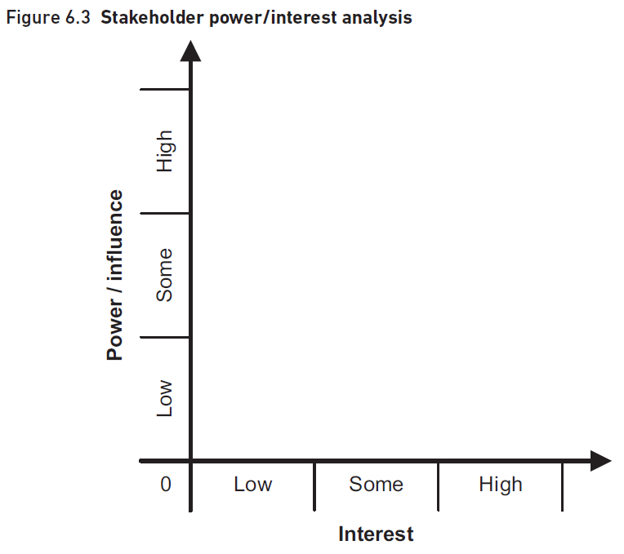
Power/Interest Grid
Power/Interest Grid Technique
Used for analysing stakeholders
Illustrated in Figure 6.3
Plotting Stakeholders
Important to plot stakeholders where they actually are
Avoid plotting where they should be or where we would like them to be
Managing Stakeholders
Explore strategies for managing stakeholders in their positions
Consider moving stakeholders to more advantageous positions
Notes:
The power/interest grid is a technique for analysing stakeholders. It's crucial to plot stakeholders accurately, not ideally. This helps in managing them effectively or moving them to better positions for project success. Original Content: One technique for analysing stakeholders is the power/interest grid illustrated in Figure 6.3. In using the power/interest grid, it is important to plot stakeholders where they actually are, not where they should be or perhaps where we would like them to be. We can then explore strategies for managing them in their positions or, perhaps, for moving them to other positions that might be more advantageous for the success of our project.

Slide 16
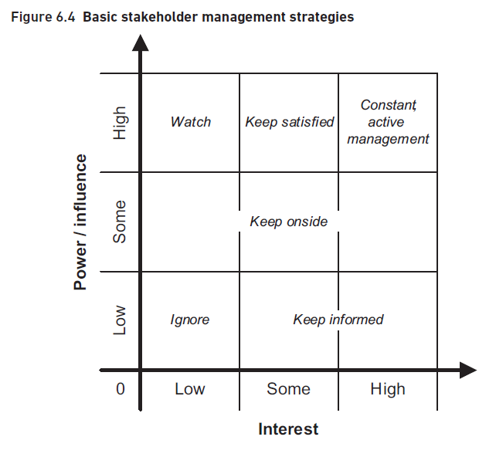
Low Interest and Low Power
Notes:
This slide discusses the categories and identification of stakeholders based on their interest and power or influence. Original Content: No or low interest and no or low power/influence STAKEHOLDER CATEGORIES AND IDENTIFICATION

Slide 17
High Interest but Low Power
Challenges in Managing Low Power Stakeholders
Directly affected by change projects
Feel powerless to influence direction
Frustration and passive resistance
Can lead to delays and suboptimal results
Basic Management Strategy
Keep stakeholders informed
Explain reasons for proposed change
Effective Management Approach
Honesty about the need for change
Highlight positive aspects of change
Emphasize negative consequences of not changing
Notes:
Managing stakeholders with high interest but low power can be challenging. They may feel powerless, leading to frustration and passive resistance. Basic strategy involves keeping them informed, but effective management requires honesty, highlighting positives, emphasizing negatives, and frequent communication. Original Content: Some or high interest but no or low power/influence These groups can be very difficult to manage effectively as, although they may be directly affected by a change project, they feel powerless to shape its direction in any way. This can result in frustration and a passive resistance to change that, though overcome by positional power, can lead to delay and less-than-optimal results. The basic management strategy here is to keep such stakeholders informed of what is going on and, in particular, of the reasons for the proposed change. But this is a rather passive approach and, in most circumstances, more effort has to be devoted to ‘selling’ the project. This can best be done by being as honest as possible about the need for change; by highlighting the positive aspects of the change or the negative consequences of not making it; and by frequent and focused communication of progress.

Slide 18

Low Interest but Some Power
Stakeholders with some power/influence
Includes middle or senior managers
Not directly affected by project direction
Regulators
Get involved if rules are breached
Can squash initiatives
People with more interest but limited power
Have some influence over the project
Approach to manage this group
Keep them supportive of the project
Frequent, positive communication
Involve them more with the project
Notes:
This group includes stakeholders with some power or influence, such as middle managers and regulators. They may not be directly affected by the project's direction but can influence it. The best approach is to keep them supportive through positive communication and involvement. Original Content: No or low to high interest but some power/influence This is a rather varied group. It includes some stakeholders like middle or senior managers who do have some power or influence but who, because their interests are not directly affected, are not very concerned about the direction a project is taking. Regulators may also fall into this category and they will only start to get involved if some breach of the rules is suspected when they could, in effect, squash an initiative. The group can also include people with more interest in the project but, again, only some power or influence over it. The best approach with this group is to keep them supportive of the project, possibly by frequent, positive communication with them but perhaps also by involving them more with the project. As the old saying has it, it is better to have them inside the glasshouse throwing stones out than outside throwing them in.

Slide 19
Low Interest but High Power
Characteristics of High Power, Low Interest Stakeholders
Senior managers with no direct interest in the project
Project may be too small or unimportant for them
May be in an area that doesn’t interest them
Risks of Ignoring These Stakeholders
Risky approach to ignore them
They may suddenly get interested due to unexpected issues
Potential to raise concerns or exert influence
Strategies to Manage Their Interest
Address their needs directly if situation arises
One-to-one meetings to ensure they do not raise concerns
Highlighting Project Impact
Notes:
Senior managers with high power but low interest in a project can pose risks if ignored. They may suddenly get interested due to unexpected issues. Directly addressing their needs through meetings can prevent concerns. Encouraging their interest and discussing project impacts can be beneficial. Original Content: No or low interest but high power/influence These are probably very senior managers who, for one reason or another, have no direct interest in the project. This may be because it is too small or unimportant for them to bother with or it may be that it is in an area that doesn’t interest them; the Group Marketing Director, for instance, probably will not be concerned about a project to streamline the stationery purchasing procedures. For many purposes, it might be thought that they can be ignored but this is actually a rather risky approach. Our Marketing Director may, for instance, suddenly get very interested in the stationery system if she keeps getting pens that don’t work or can’t get hold of any sticky notes for a conference! So, if a situation arises that might cause them to take a greater interest in the project, we might want to address their needs directly, via one-to-one meetings perhaps, in order to ensure that they do not start to raise concerns or even decide to exert their influence. In some situations it is possible that we may wish to encourage the increased interest of influential stakeholders, for example, if we felt that their support would help achieve the project objectives. Where this is the case, we may need to highlight any aspects of the project that will have a direct impact upon the stakeholder’s business area; some form of discussion will be required which, with very influential stakeholders, would typically involve a meeting.

Slide 20
High Interest and High Power
Indirect Interest Stakeholders
Have real power but indirect interest
Strategy: Keep them satisfied to prevent obstruction
Alternatively, involve them actively for resource availability
High Interest and High Power Stakeholders
Key players with power to influence project success
Determine if stakeholders are positive or negative
Sustain enthusiasm of positive stakeholders
Understand concerns and opinions of key stakeholders
Keep key stakeholders informed at all stages
Managing Negative Key Players
Find personal benefits for them in the proposed action
Notes:
Effective stakeholder management involves strategies to keep indirect interest stakeholders satisfied or actively involved. Key players with high interest and power must be managed by understanding their concerns and keeping them informed. Negative key players can be managed by finding personal benefits or engaging a powerful counterforce. Original Content: These people have some interest in the project – probably an indirect one as it is happening within or affecting their empire – and they have real power. The usual stakeholder management strategy here is to keep them satisfied and, perhaps, to prevent them from taking a more direct (and hence, possibly, more obstructive) interest in the project. In other circumstances, the strategy may be precisely the opposite – to get the stakeholder more actively involved in a project. For example, if the finance director of an organisation can be persuaded to get positively involved in a project, they will often be a powerful force for success, since they can make resources available that would otherwise be hard to come by. High interest and high power/influence These are the key players, the people who are both interested in the project and have the power to make it work or not. Often, the key players are the managers of the functions involved in a project. Initially, it is important to determine if individual key stakeholders are positive or negative in their approach to a project. If positive, then their enthusiasm must be sustained, especially during times of difficulty. It is also important to appreciate the concerns and opinions of key stakeholders and you will need to take these into account when making any recommendations. For example, if one of the key stakeholders has a particular solution in mind it is important to know about this as early as possible in order to ensure that, at the very least, the solution is evaluated as one of the options. It is also vital that the key stakeholders understand the progress of the project and why certain decisions have been made. These are the people to whom any final recommendations will be presented and who will have the final say on any decisions. They need to be kept informed at all stages of the project so that none of the recommendations come as a shock to them. Those key players who are negatively inclined towards a project can be managed in various ways, depending on the circumstances: By far the best approach is to find some personal benefits for them in the proposed course of action. The stakeholder perspective analysis techniques described below can be very useful here. Alternatively, a more powerful counterforce must be found to outweigh their negative influence. This may mean engaging the interest of someone in one of the high power areas of the grid.

Slide 21
Individuals and Groups of Stakeholders
Impact of Individual Customers
Negative reviews on social media can amplify their power
Organizing petitions or complaining to consumer groups increases influence
Example of Coca-Cola
Reintroduced traditional Coke due to customer revolt
Power of Individual Employees
Marginalized employees gain power through trade unions
Government employees can cause difficulty by whistleblowing
Importance of Considering Stakeholders
Individuals can form powerful groups
Social media enhances their ability to gain strength
Notes:
Individuals and groups of stakeholders can significantly impact organizations. Negative reviews on social media and organized petitions can amplify the power of individual customers. Coca-Cola's reintroduction of traditional Coke due to customer revolt is a classic example. Employees gain power through trade unions, and whistleblowing can cause difficulties. Stakeholders should be considered as potential groups, especially with social media enhancing their strength. Original Content: Individuals and groups of stakeholders An individual customer may not be of much concern to an organisation such as a big supermarket chain. But if they post a negative review using social media, write to newspapers, organise petitions or complain to consumer groups, they can increase their level of power considerably. A lot of ‘people power’ can damage even large concerns considerably and force them into major reversals of course. The classic example of this is the mighty Coca-Cola being forced to reintroduce its traditional Coke in the face of a massive worldwide customer revolt against a new formula. Similarly, individual employees can be marginalised by an organisation but, if they are members of a trade union, their power is greater. A single government employee who objects to a policy may be relatively powerless but if they ‘blow the whistle’ to national newspapers, they can cause considerable difficulty. These examples illustrate the dangers of ignoring the weakness of an individual or mistaking individual weakness for collective weakness. Stakeholders must be considered not just as individuals but as potential groups as well. Their ability to gain strength, particularly with the availability of social media mechanisms, should never be underestimated.

Slide 22

Summary of Stakeholder Management Strategies
Basic Strategies Overview
Summarized in Figure 6.4
Individual stakeholders vary
Tailored Management Approaches
Each stakeholder requires a unique approach
Dynamic Stakeholder Positions
Stakeholders change over time
Management strategies must adapt
Notes:
The basic strategies for stakeholder management are summarized in Figure 6.4. Individual stakeholders vary and require tailored management approaches. Stakeholders change over time, necessitating adaptable management strategies. Original Content: SUMMARY OF STAKEHOLDER MANAGEMENT STRATEGIES The basic strategies for stakeholder management are summarised in Figure 6.4 but individual stakeholders will not fit neatly into one of the nine types and management approaches must be tailored for each. Also, as we shall discuss in the next section, stakeholders do not stay in the same place over time and so the ways they are managed must be adapted accordingly.

Slide 23
Dynamic Stakeholder Positions
Stakeholder positions change over time
Managers may get promoted, altering their interest and power
Managers may lose interest if promoted to a broader role
Organizational circumstances can shift
Senior managers may focus more on IT projects
External factors can influence stakeholder interest
Competitor scandals may increase regulatory scrutiny
Continuous stakeholder analysis is essential
Monitor changes in stakeholder positions
Re-evaluate management strategies
Develop a management plan for stakeholders
Use a one-page assessment or a comprehensive spreadsheet
Notes:
Stakeholder positions are dynamic throughout a project's life. Managers may get promoted, changing their interest and power. Organizational shifts and external factors like competitor scandals can influence stakeholder interest. Continuous analysis and re-evaluation of management strategies are crucial. Develop a management plan using assessments or spreadsheets. Original Content: Stakeholders’ positions on the framework in Figure 6.4 do not remain static during the life of a project. At the most obvious level, a manager may get promoted so that, from being in the high interest/low power situation, is now both interested and powerful. Alternatively, the manager may lose interest in a project if promoted into a job with a wider remit. The circumstances of an organisation may change so that senior managers begin to focus more on IT projects. A scandal within a competitor organisation may cause a regulator to take a closer interest in all companies in a sector. This means that stakeholder analysis must be a continuing activity throughout the project – and even afterwards to find out what the stakeholders thought of the final outcome. The project team and project manager should be constantly on the lookout for changes in stakeholders’ positions and should be re-evaluating their management strategies accordingly. Once stakeholders’ initial positions have been plotted, a plan should be drawn up for managing each of them and how to approach it. A one-page assessment can be made for each stakeholder but a more useful approach would be to see all stakeholders at a glance by setting up a spreadsheet using the following headings:

Slide 24
Stakeholder Management Plan
Messages to Convey
Define emphasis on communications
Identify and highlight issues of interest
Tailor messages to each stakeholder
Actions and Communications
Define actions for each stakeholder
Keep stakeholders informed positively
Engage stakeholders actively
Evaluate and adapt strategies
Manage high interest/high power stakeholders
Stakeholder Information
Desired Support and Role
Notes:
To advance the project, we need to tailor our communications to each stakeholder, define actions, and manage high interest/high power stakeholders. Record stakeholder information, assess their attitude, and determine desired support and role. Original Content: What we would like the stakeholder to do, if at all possible, to advance the project. Messages to convey This is where we define the emphasis that should be put on any communications to this stakeholder. For example, we might need to identify and highlight any issues that are of particular interest to this stakeholder. The messages are likely to be tailored to each stakeholder and so the more we know about them and their concerns, the more effective our communications will be. Actions and communications This is the most important part of the plan, where we define exactly what actions we will take with regard to this stakeholder. It may be just to keep them informed, in a positive way, about the project and progress to date. Alternatively, it may be a more active approach, for example meeting them to engage their interest in the project. Where a strategy has been devised to change a stakeholder’s position – perhaps to encourage someone to take a closer interest – then its success must also be evaluated and other approaches developed if the desired results are not being achieved. As mentioned earlier, the high interest/high power stakeholders are the key players and require positive management, such as frequent meetings and discussions about the direction the project is taking. This will help make sure that they are kept informed about a project and are happy with the approach that we are taking. Perhaps just as important, we will understand when their opinions or issues have changed and will reflect this in the project direction and work as appropriate. Name of stakeholder It may also be useful to record their current job titles. Current power/influence From the grid. Current interest From the grid. Issues and interests This is a brief summary of what interests each stakeholder and what we believe their main issues with the project are likely to be. Current attitude Here, we need to devise a classification scheme, perhaps using the following descriptions: Champion: will actively work for the success of the project. Supporter: in favour of the project but probably will not be very active in promoting it. Neutral: has expressed no opinion either in favour or against the project. Critic: not in favour of the project but probably not actively opposed to it. Opponent: will work actively to disrupt, impede or derail the project. Blocker: someone who will just obstruct progress, possibly for reasons outside of the project itself. Desired support What we would ideally like from this stakeholder, perhaps using a simple scale of high, medium or low. Desired role We may wish to get this stakeholder actively involved in the project, perhaps as the project sponsor or as part of a steering committee. Desired actions

Slide 25
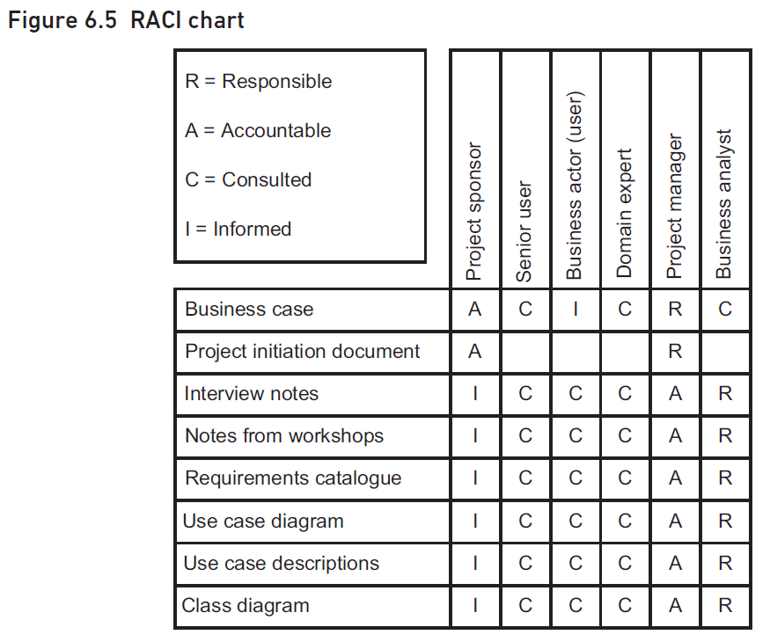
RACI Chart Explanation
Purpose of RACI Chart
Helps in deciding management strategy for stakeholders
Useful in business analysis projects
Structure of RACI Chart
Lists main products/deliverables down the side
Lists various stakeholders along the top
RACI Categories
Responsible: Person/role responsible for creating/developing the product/task
Accountable: Person/role accountable for the quality of the product/task
Consulted: Person/role providing information input to the product/task
Informed: Stakeholders informed about the product/task
Example from Figure 6.5
Notes:
A RACI chart is a useful tool in business analysis for managing stakeholder involvement. It lists products and stakeholders, indicating their roles as Responsible, Accountable, Consulted, or Informed. For example, a business analyst is responsible for interview notes, while the project sponsor is accountable for the business case. Original Content: Apart from deciding on the management strategy for the various stakeholders, it can also be very useful in a business analysis project to consider the tasks or deliverables and the extent to which the stakeholders are involved with them. A simple and effective method for achieving this is to create a RACI chart as illustrated in Figure 6.5. A RACI chart – more formally known as a ‘linear responsibility matrix’ – lists the main products/deliverables down the side and the various stakeholders along the top. Where a stakeholder intersects with a product, we indicate their involvement using one of the RACI categories, which mean: Responsible: This is the person or role responsible for creating or developing the product or performing the task. In Figure 6.5, for example, a business analyst is responsible for creating the interview notes. Accountable: The person or role who will ‘carry the can’ for the quality of the product or task. The project sponsor, for instance, must ultimately be accountable for the business case for a project. Consulted: This person or role provides information that is input to the product or task. In Figure 6.5, the senior user, other business actors and the domain expert are shown as being consulted during the interviews and workshops. Informed: These stakeholders are informed about a product or task, though they may not have contributed directly to them. For example, the project sponsor has the right to be kept informed about any of the products being produced during the project.

Slide 26
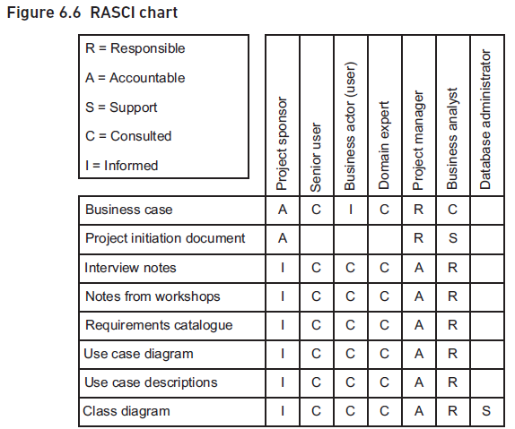
RASCI Chart Explanation
RASCI Chart
Includes an additional category S for 'support'
Support role provides assistance and resources
Example: Business analyst supports project manager
Example: Database administrator supports business analyst
Linear Responsibility Matrix
Includes categories I, E, A, C, and S
I for initiation
E for execution
A for approval
C for consultation
S for supervision
Notes:
A RASCI chart includes a support role that provides assistance and resources. For example, a business analyst supports the project manager. Another scheme, the linear responsibility matrix, includes categories such as initiation, execution, approval, consultation, and supervision. Original Content: A RASCI chart, shown in Figure 6.6, uses a similar approach but has an additional category S for ‘support’. This person (or role) will provide assistance, and sometimes resources, to whoever is responsible for the product/deliverable. For example, in Figure 6.6, the business analyst is shown as supporting the project manager in the creation of the project initiation document and the database administrator supports the business analyst in developing the class diagram. Yet another scheme that could be used on a linear responsibility matrix includes I (initiation), E (execution), A (approval), C (consultation) and S (supervision).

Slide 27
Researching Stakeholders
Traditional Stakeholder Management Challenges
Entering organizations with little prior knowledge
Difficulty in understanding stakeholder roles and relationships
Advantages of Social Media for Business Analysts
Access to additional resources for stakeholder research
Enhanced ability to manage stakeholder relationships
Using LinkedIn for Stakeholder Research
Investigating stakeholder roles and career history
Identifying common contacts for introductions
Notes:
In the past, stakeholder management often meant entering an organization with little knowledge of its people. Social media, especially LinkedIn, now provides business analysts with tools to research stakeholders' roles and career histories, and find common contacts for introductions. Original Content: Once upon a time, in stakeholder management, there really was no alternative to coming into an organisation ‘cold’ with little understanding of who was who and where they fitted in. However, the availability of social media offers the business analyst additional resources to learn about stakeholders and to manage the relationships with them. One obvious way of using social media is to use sites such as LinkedIn to carry out research about stakeholders. What is their role? What have they done previously in their careers? Do we have any contacts in common who could introduce us?

Slide 28

Communicating with Stakeholders
Considering Social Media for Stakeholder Communication
Facebook and Twitter as cost-effective communication tools
Effective for frequent updates to large groups
Stakeholder Categories
'Low/low' category stakeholders can be ignored
No direct interest or influence over the project
Building Community
Creating a sense of involvement
Keeping stakeholders informed
Notes:
Once the business analysis project starts, social media like Facebook and Twitter can be used to communicate with stakeholders. These platforms are cost-effective for frequent updates to large groups, even those with low interest or influence. This helps build a sense of community and keeps everyone informed. Original Content: Once the business analysis project is underway, other forms of social media might be considered for communicating with stakeholders. For example, when considering the ‘low/low’ category in Figure 6.4 we said that these stakeholders could effectively be ignored as they have no direct interest in or influence over the project. However, resources such as Facebook and Twitter offer a cost-effective way of communicating with large groups of people on a frequent basis and keeping them informed. This can help to build a sense of community and make people feel involved in what is going on.

Slide 29
Introduction to Perspectives
Identifying Stakeholders
Knowing who the stakeholders are
Assessing their influence on the project
Understanding Stakeholder Attitudes
Evaluating their support for the project
Recognizing Business Perspectives
Understanding stakeholders' views on business activities
Considering ethical responsibilities
Utilizing Soft Systems Methodology (SSM)
Applying elements from Peter Checkland’s SSM
Modeling different business systems
Notes:
In business analysis, it's crucial to identify stakeholders and understand their influence and attitudes. Recognizing their business perspectives, including ethical considerations, is vital. Utilizing Peter Checkland’s Soft Systems Methodology helps model different business systems to fulfill these perspectives. Original Content: Introduction It is all very well knowing who the stakeholders are and what is likely to be their influence on a business analysis project. It is also important to understand their attitude – how supportive are they of what we are trying to achieve? But it is also vital to understand what they think, in other words what are their business perspectives? For example, in a commercial organisation, one stakeholder might feel that any activities are allowable as long as they are not actually illegal, whereas other stakeholders may feel that the organisation has some responsibility towards society at large and therefore conclude that some activities should be avoided on ethical grounds. To help us understand these stakeholder perspectives, and to model the different business systems that would fulfil them. we can utilise some of the elements from Peter Checkland’s Soft Systems Methodology (SSM; Checkland 1999).

Slide 30
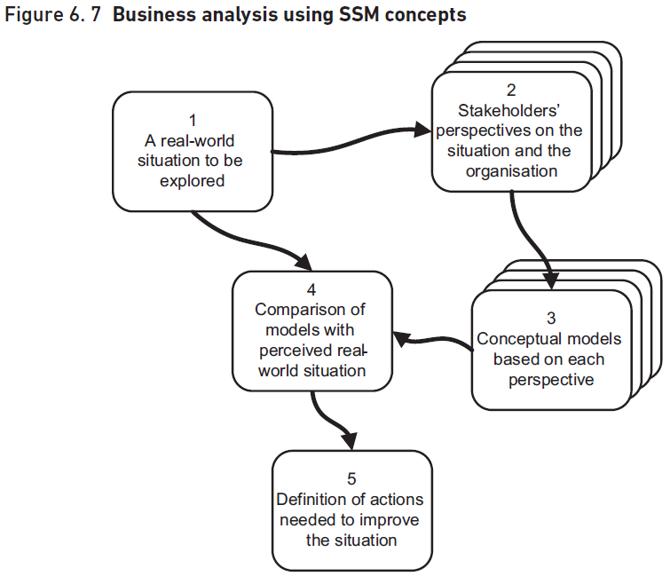
Soft Systems Methodology
Origin and Purpose of SSM
Devised by Peter Checkland and team at Lancaster University in the 1980s
Designed to understand complex real-world situations
Application in Business Analysis
Utilizes elements and concepts from SSM
Illustrated in Figure 6.7
Stakeholder Perspectives
Different views on the 'problem'
Varied opinions on necessary actions
Main Stages of SSM
Five key stages to be applied
Notes:
Soft Systems Methodology, devised by Peter Checkland in the 1980s, helps understand complex real-world situations. It is applied in business analysis, illustrated in Figure 6.7. Stakeholders often have different views on problems and actions. SSM involves five main stages. Original Content: Soft Systems Methodology Peter Checkland and his team at Lancaster University devised SSM in the 1980s as a way of understanding complex real-world situations. The basic premise underlying SSM is that real-world situations are rarely simple and are often very complex. An approach to business analysis, based upon elements and concepts from the SSM, is illustrated in Figure 6.7. When investigating business situations, it is often the case that stakeholders have different views about what the ‘problem’ is and also about what needs to be done. As Figure 6.7 shows, there are five main stages that should be applied:

Slide 31
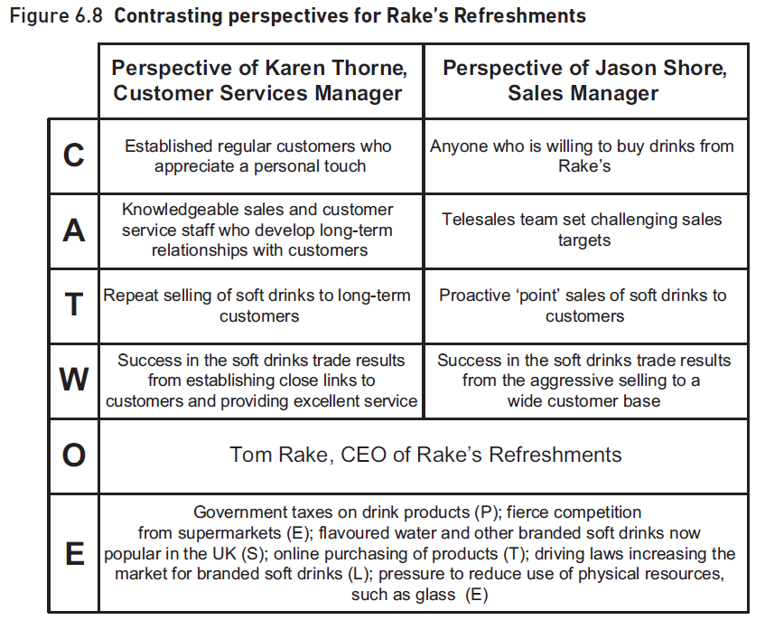
CATWOE Analysis
Identifying the Situation
Loss of market share or poor public perception
Investigating issues and causes
Seeking Stakeholders' Views
Understanding what the organization is about
Determining what it should be doing
Creating Conceptual Models
Models based on each stakeholder's perspective
Showing what the organization should do
Comparing Models with Real-World Situation
Defining Actions
CATWOE Analysis
Notes:
We start by identifying the situation and investigating issues. Stakeholders' views are sought to understand the organization. Conceptual models are created from these perspectives and compared with the real-world situation. Actions are defined to implement the consensus model. CATWOE analysis helps explore stakeholders' perspectives. Original Content: 1. The situation is identified, for example the loss of market share by a company or the poor public perception of a public body, and the issues and causes are investigated. 2. Stakeholders’ views – perspectives – are sought about what the organisation is about, what it should be doing and so forth. 3. From each stakeholder’s perspective, a conceptual model is created to show what the organisation should do to fulfil the perspective. 4. These conceptual models are compared with the real-world situation and a consensus model is generated, possibly by combining elements from various stakeholder’s perspectives. 5. Actions are defined to address the situation by implementing the consensus model in place of whatever is happening currently in the organisation. Analysing the perspectives – CATWOE SSM provides us with a very useful tool that we can use to explore the stakeholders’ perspectives. Although the technique is known as CATWOE, experience shows that exploring the CATWOE elements is actually best done in the following order: W = Weltanschauung or worldview This summarises a stakeholder’s beliefs about the organisation or business system, which explain why it exists and what it should be doing. If we consider the soft drinks merchant business that was discussed in Chapter 5, the newly appointed Sales Manager believes that success in the soft drinks trade results from proactively contacting potential customers and convincing them to buy. However, the Customer Services Manager believes that success results from establishing close links with regular customers and providing them with excellent service. T = Transformation This is the principal business activity of the business system, in other words what lies at the heart of its operations. (Checkland used the term ‘transformation’ here because, at the highest level of abstraction, all systems exist to transform some form of input into some form of output.) In the case of the drinks supplier, the Sales Manager’s worldview leads to a transformation that consists of making one-off ‘point sales’, whereas the Customer Services Manager thinks that it is about providing a high quality of service throughout the sales process, in order to establish relationships with customers. C = Customer(s) Stakeholders can differ, too, in their views of who their customers are (or should be). In our example, one view might be ‘anyone willing to buy from us’ whereas another might be ‘established regular customers who appreciate a personal touch’. Another way of thinking about customers is to ask ‘who is on the receiving end of the transformation?’ A = Actor(s) These are the people who carry out the transformation, for example telesales staff set challenging targets or knowledgeable salespeople and customer services staff capable of establishing long-term relationships with customers. O = Owner(s) The perspective is someone’s view of a business system, so the question is who ultimately controls that system and who could instigate change, or even closure, if necessary. Who, for example, could decide between the two competing worldviews about the drinks supplier? In this case, the owner is the business’s chief executive but, in other situations, it could be a group, like a board of directors. E = Environment Finally, all organisations operate within the constraints imposed by their environment. PESTLE – explored in Chapter 3 – can be used to identify the main external factors but, in some situations, things like organisational policies can also feature here. Figure 6.8 presents CATWOE analyses from the two stakeholders’ perspectives. In Figure 6.8, the owner and environment for both perspectives is the same. This can be the case when using CATWOE, although sometimes different perspectives may yield differences in these areas. For example, we might consider a further environment constraint to be the willingness of people to buy soft drinks on receipt of an unsolicited telephone call.

Slide 32
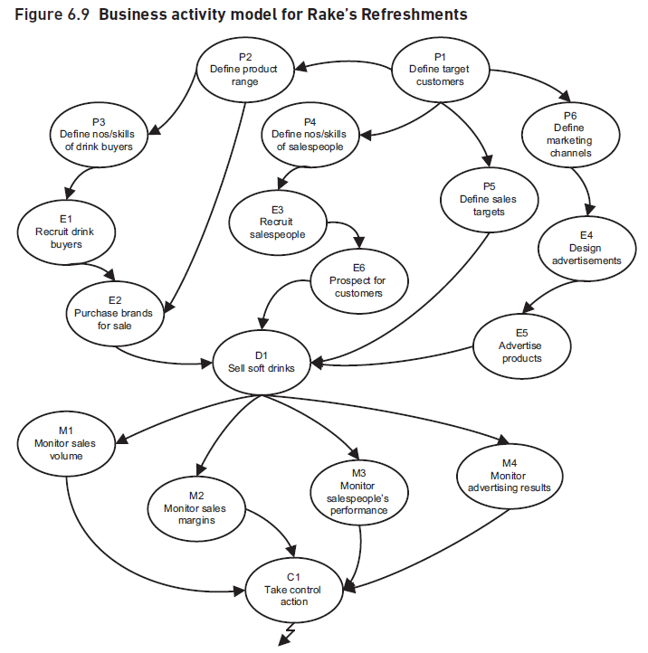
Business Activity Models
Conceptual Model of Stakeholder Perspectives
BAM shows what the organization should be doing
Business process model shows how it does these things
Creating a BAM
Identify activities from stakeholder perspectives
Combine perspectives to achieve consensus
Steps to Create a BAM
Identify DOING activities
Add ENABLING activities
Include PLANNING activities
Control Activities Observations
Example: Rake’s Refreshments
Notes:
Business activity models (BAM) illustrate stakeholder perspectives on what the organization should be doing. Creating a BAM involves identifying activities from each perspective, combining them, and achieving consensus. Steps include identifying DOING, ENABLING, PLANNING, MONITORING, and CONTROL activities. Example perspectives from Rake’s Refreshments show differences between Sales and Customer Services Managers. Original Content: Illustrating the perspectives – business activity models Business activity models (BAM) provide a conceptual model of what we would expect to see to fulfil a particular stakeholder perspective. A BAM shows what the organisation should be doing, as opposed to a business process model (discussed in Chapter 7) which explores how it does these things. Creating a BAM requires the business analyst to think about the activities that each stakeholder’s perspective implies. Initially, there will be one BAM for each distinct perspective. At a later point, these are examined in order to identify where there is agreement or conflict between the BAMs. Ultimately, the aim is to combine them and, in discussion with the stakeholders, achieve a consensus BAM. The approach for creating a BAM is as follows and a completed BAM for Rake’s Refreshments (drawn from the perspective of the Sales Manager) is shown in Figure 6.9: 1. Identify the DOING activities that are at the heart of the model. These are derived from the transformation of CATWOE and reflect the organisation’s principal business activities. In the case of the drinks supplier, there is one doing activity ‘sell soft drinks’. 2. ENABLING activities are next added. These lead into the doing activities on the model and acquire or replenish the resources needed to carry them out. In Figure 6.9, for example, there are activities to recruit and train salespeople and to advertise the company’s products. 3. All of the activities of the organisation should follow from PLANNING activities. Normally, on a BAM, we would not show the strategic planning activities – setting the general direction of the organisation for instance – as we are interested in the planning required within this business system (which will support the strategy execution). In Figure 6.9, we plan how many salespeople are needed, and what skills they require, and we plan how best to market the products to the customers. Planning activities also include setting targets, such as KPIs (discussed in Chapter 3) against which the performance of the business system can be measured. 4. The actual evaluation of the performance is done within the MONITORING activities, for example, in Figure 6.9 monitoring the performance of the salespeople. 5. Finally, if the monitoring activities reveal that performance is not what was expected in the plans, CONTROL activities may be required to institute the necessary remedial actions. With regard to the control activities, two observations are relevant: 1. On a BAM, we could associate a control activity with each monitoring activity and some users of the technique prefer to shown them this way. However, in the real world, managers often take action as a result of a range of measurements so a less cluttered model can be created by feeding all of the monitoring activities into one control activity, as in Figure 6.9. 2. The control actions themselves could feed back into any of the other activities on the model. Since trying to show this would create an impossible-to-understand diagram, the convention is to show a ‘lightning strike’ symbol emanating from the control activity which means that it feeds back into the model wherever it is relevant. The model shown in Figure 6.9 represents Rake’s Refreshments as seen from the perspective of Jason Shore, Sales Manager. As we have seen, though, the Customer Services Manager, Karen Thorne, sees the organisation rather differently. Both managers agree that ‘Sell soft drinks’ is at the heart of the business but, for Jason Shore, this means proactively contacting new customers and pushing them to buy Rake’s Refreshments; Karen envisages selling to existing customers who contact Rake’s to ask for advice and guidance on what to buy. If the model had been built from Karen’s perspective, it would probably not contain the enabling activity E6 ‘Prospect for customers’ but it would have included activities to recruit and train customer service staff, possibly as brand advisors. There would also have been an activity to monitor the level of customer satisfaction.

Slide 33
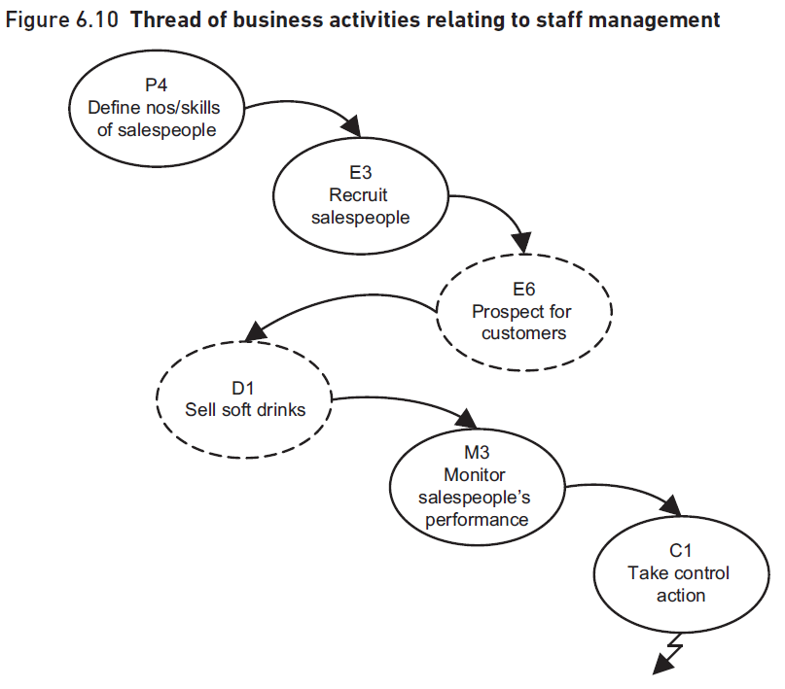
Activity Threads in BAMs
Grouping Business Activities
Useful to consider related activities together
Example: Recruitment, training, and management of salespeople
Extracted Activities
Activities E6 and D1 shown for completeness
Not relevant to this investigation
Purpose of Grouping
Consider entire process of recruitment, training, measurement, and control
May apply to other staff as well
Potential Findings
Poorly defined jobs
Ineffective recruitment processes
Notes:
Grouping related business activities into threads can be more useful than considering them individually. For example, recruitment, training, and management of salespeople can be grouped together. This helps in analyzing the entire process and identifying issues such as poorly defined jobs, ineffective recruitment, and incorrect targets. Original Content: Activity ‘threads’ in business activity models Sometimes, rather than considering individual business activities, it is more useful to group them into ‘threads’ of related activities. For example, in Figure 6.10, we have extracted from Figure 6.9 those activities related to the recruitment, training and management of salespeople. (Activities E6 and D1 are shown for completeness but are not relevant to this investigation.) The reason for this is that perhaps we would like to consider the entire way in which the organisation recruits, trains, measures and controls their salespeople (and maybe other staff too). We may find, for example, that the jobs are poorly defined, ineffective recruitment processes are being used, salespeople are being set the wrong targets and so on.

Slide 34
Summary
Importance of Stakeholder Management
Key to success of business analysis projects
Should begin at inception stage
Continued throughout the project and afterwards
Roles and Responsibilities
Project manager has key responsibility
All team members have roles to play
Assessment of Stakeholders
Interest in the project
Power or influence over the project
Exploring Stakeholder Perspectives
Techniques for Revealing Stakeholder Values
Notes:
Effective stakeholder management is crucial for business analysis projects. It starts at the inception stage and continues throughout the project. The project manager leads, but all team members contribute. Stakeholders are assessed by their interest and influence. Techniques like CATWOE and BAM help reveal their values and priorities. Original Content: SUMMARY Effective stakeholder management is key to the success of any business analysis project. It should begin before the project starts, at the inception stage, and be continued throughout the project – and even afterwards to ensure that the changes are implemented effectively. Although the project manager has the key responsibility in this area, all team members have roles to play. Stakeholders can be assessed in terms of their interest in the project and their power or influence over it and strategies must be defined to actively manage them in accordance with this assessment. The stakeholder perspectives should also be explored in order to uncover strongly held beliefs and potential conflicts. Techniques such as CATWOE and BAM are extremely helpful in revealing where the stakeholders’ values and priorities lie, and exploring what should be done within the business system to fulfil their perspectives.

